Slide 1
Mac 286 Project Data Visualization on World Happiness Report
By: Liang Fang
Date: 12/2/2018

Slide 2
What is Data Visualization?
Data visualization is viewed by many disciplines as a modern equivalent of visual communication.
It involves the creation and study of the visual representation of data.
To communicate information clearly and efficiently, data visualization uses statistical graphics, plots, information graphics and other tools.

Slide 3
World Happiness Report - 2017
Different people may hold different definitions on this word. Simply put, happiness is the state of being happy.
Where are the top 10 happiest countries in the world, why them?
World happiness is more complicated topic – many more indicators involved.
It includes economy, family, life expectancy, freedom, trust, generosity.

Slide 4

Where are the data from?
World Happiness Report – from Kaggle.com, a free open datasets website.
World Happiness Report is a landmark survey of the state of global happiness.
The latest World Happiness Report of 2018 was released in Rome, March 14, 2018. But the data is still not available to the public yet.
Finland Wins Double Gold in World Happiness Report 2018
http://worldhappiness.report/news/2018/03/14/finland-wins-double-gold-in-2018-world-happiness-report/.

Slide 5
Programming Languages and Libraries
Python –
Numpy # offers fast and efficient processing numerical data structures
Pandas # offers the flexibility to read and write different data format, such as CSV, text files, it also has integrated plotting functionalities
Matplotlib # a library that enables us to plot the graph and visualize the data
seaborn # a Python data visualization library based on top of matplotlib for making statistical graphics
R Programming –
library(ggplot2) # Data visualization
library(readr) # CSV file I/O, e.g. the read_csv function
library(ggpubr) # Arrange data
library(rworldmap) # Display a worldmap

Slide 6
Variables Presented in the Data
Happiness Rank
Happiness Score
Country
Economy: GDP per capita
Family
Health/Life expectancy
Freedom
Trust
Generosity
Dystopia Residual

Slide 7
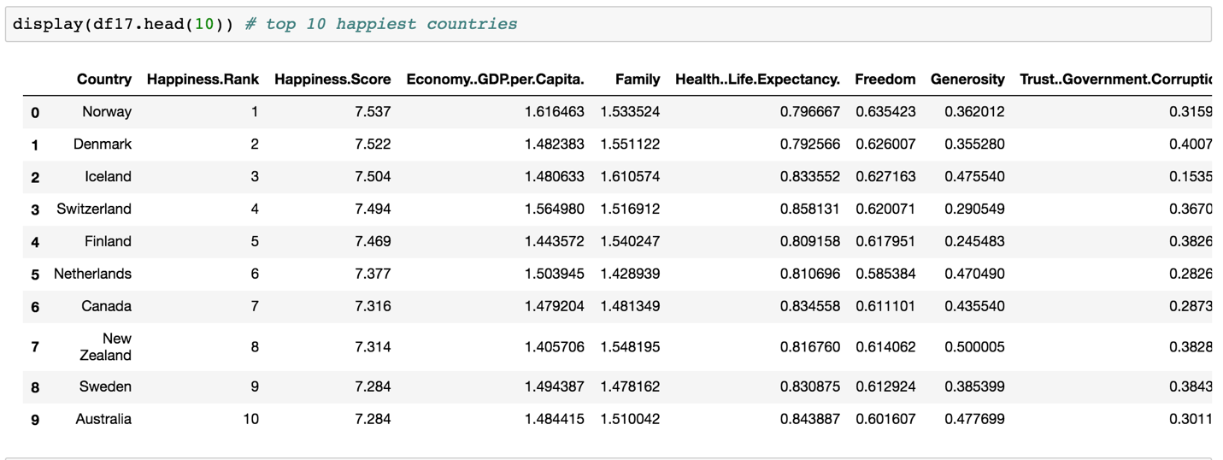
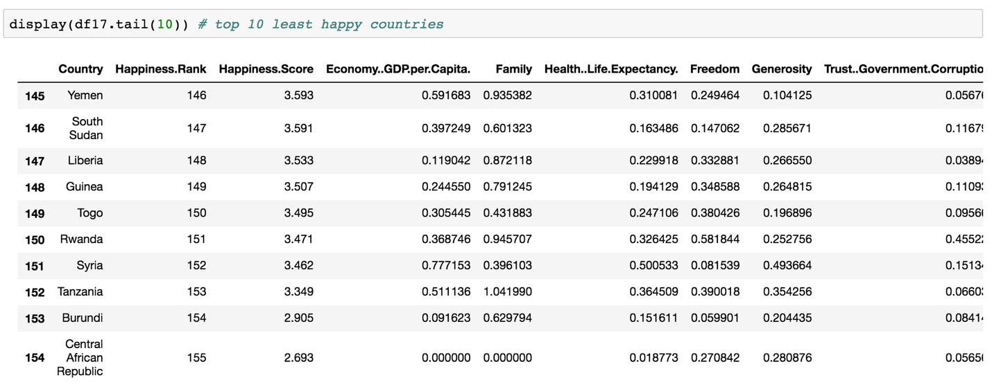
Top 10 and bottom 10 Countries in Happiness

Slide 8
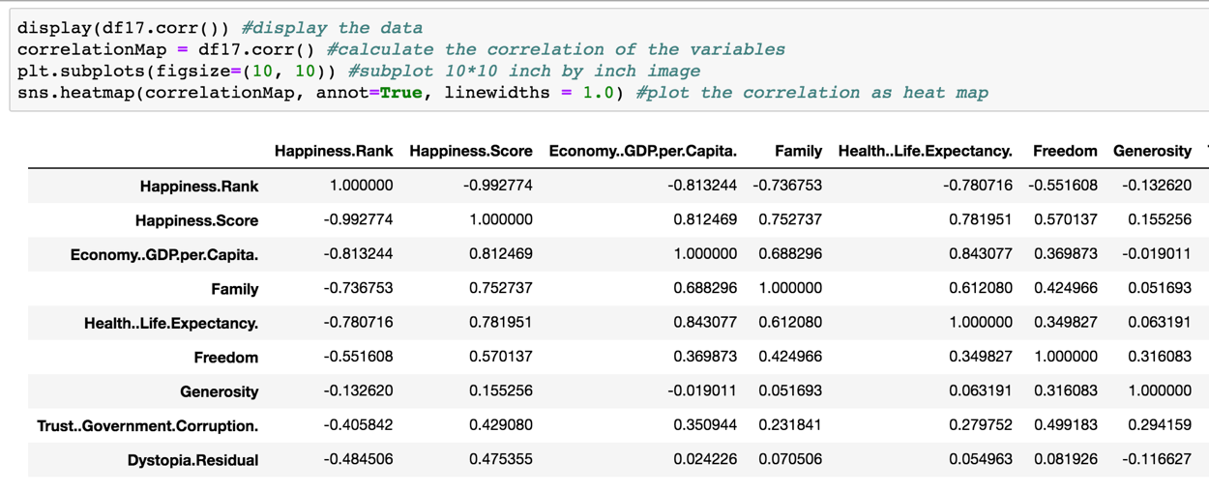
Correlation between the variables and happiness

Slide 9
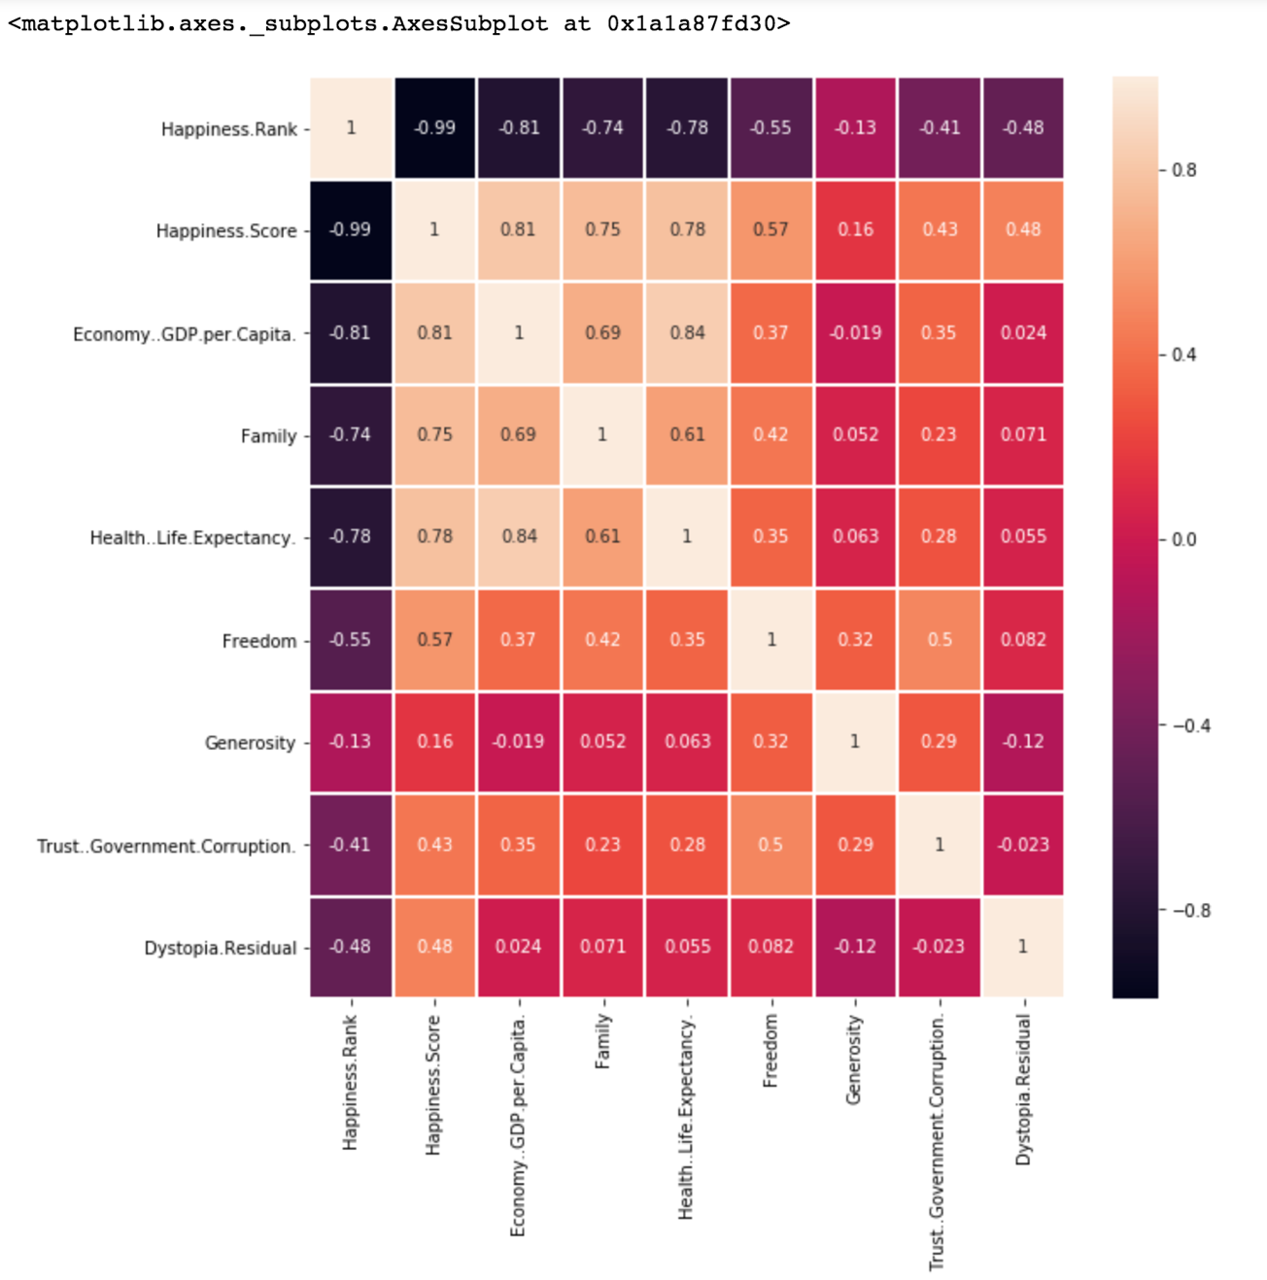
Correlation on a Heat Map

Slide 10
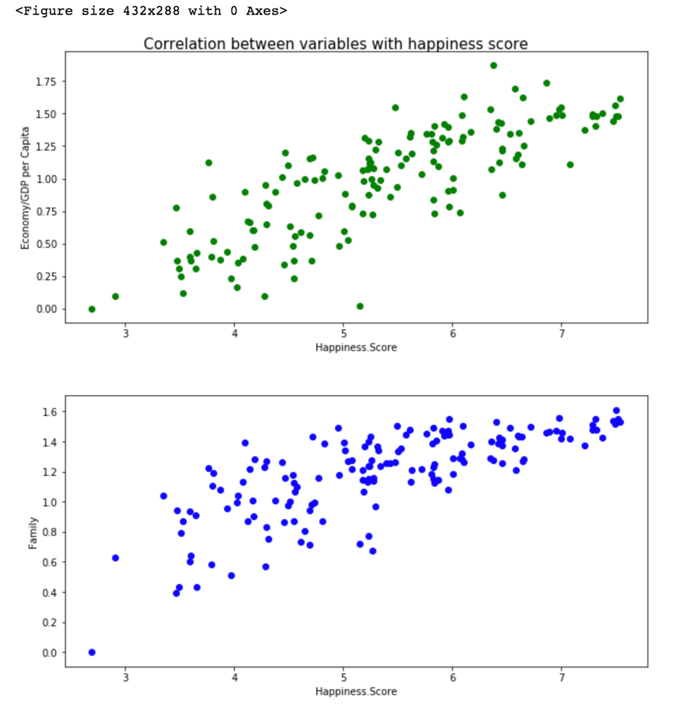
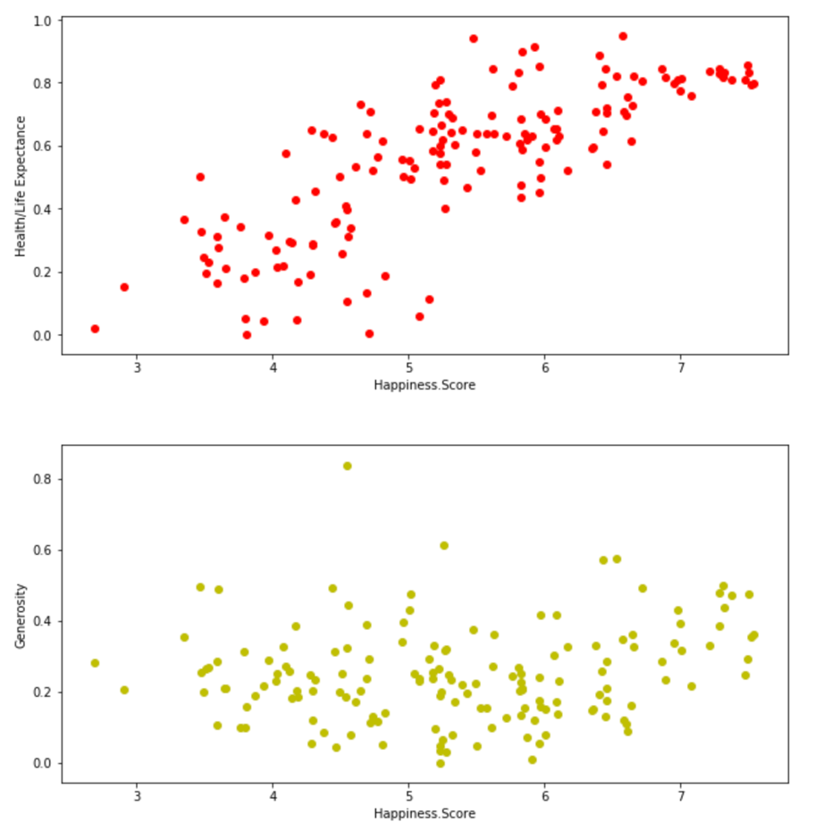
Correlation on Scatter Plots

Slide 11
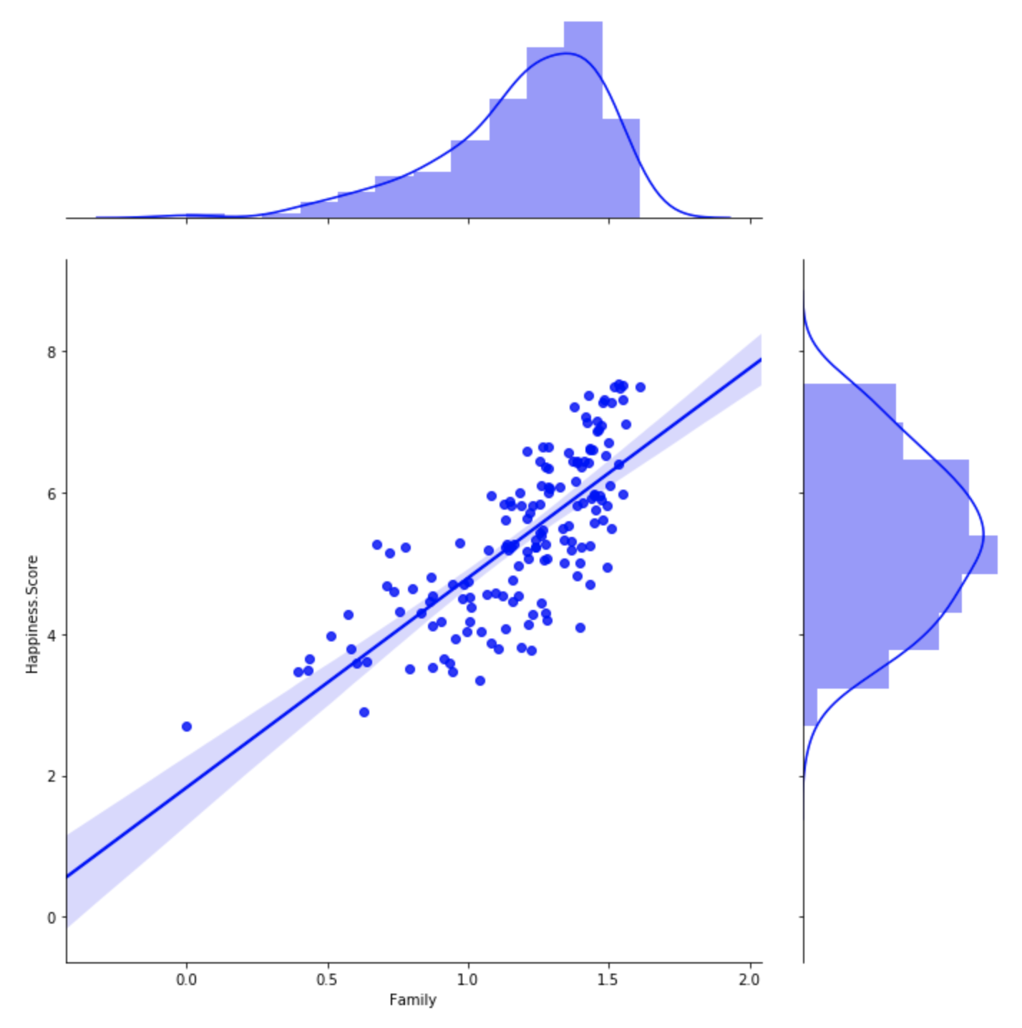
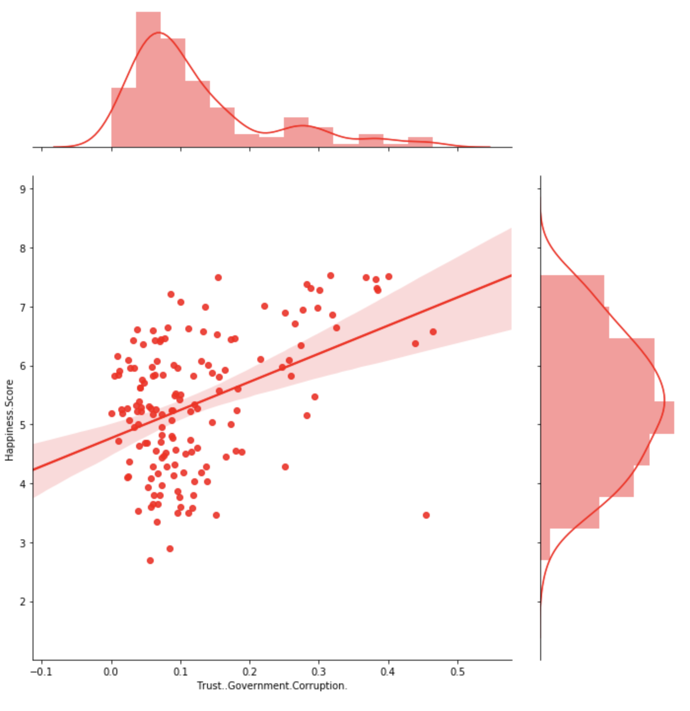
Linear regression line with normal distributions

Slide 12
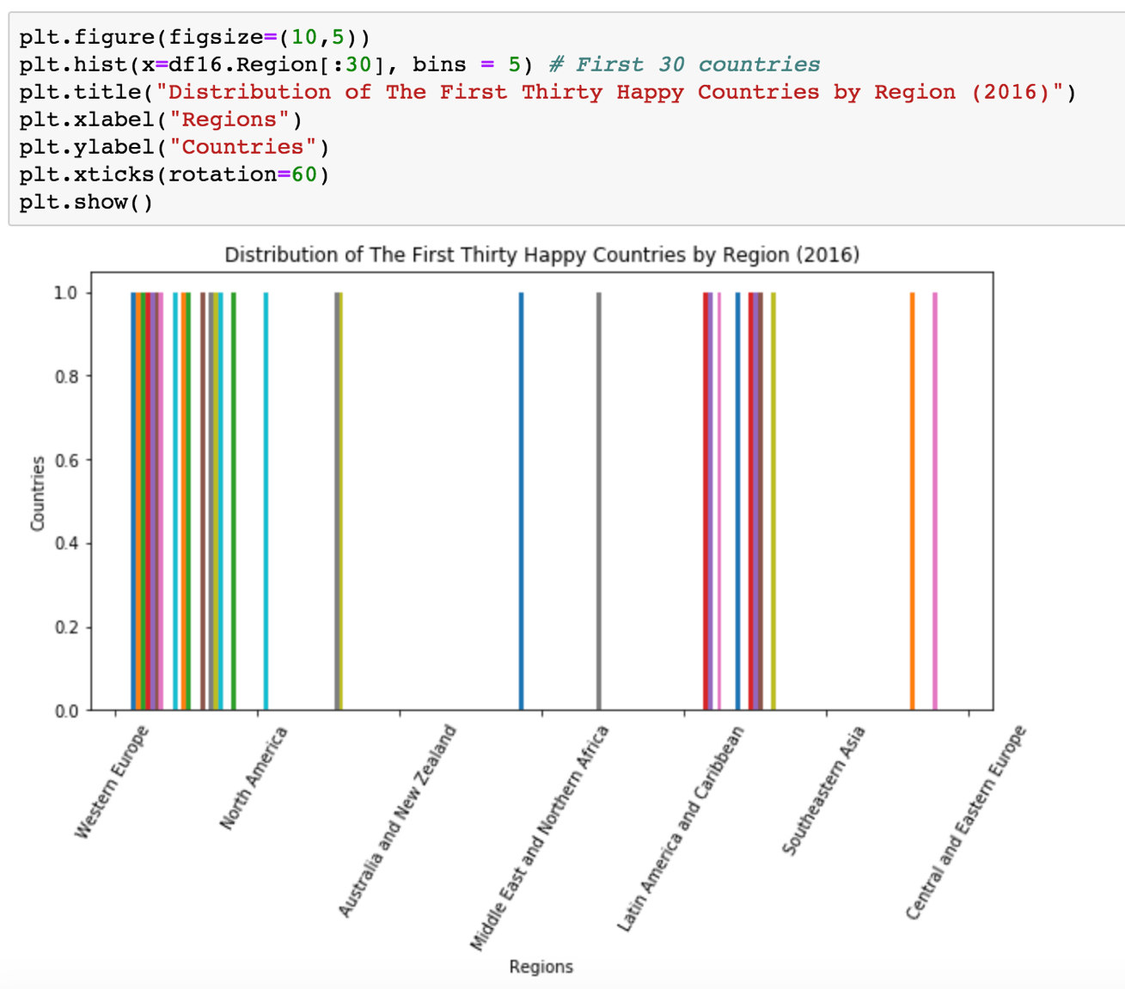
Continents that have the happiest countries

Slide 13
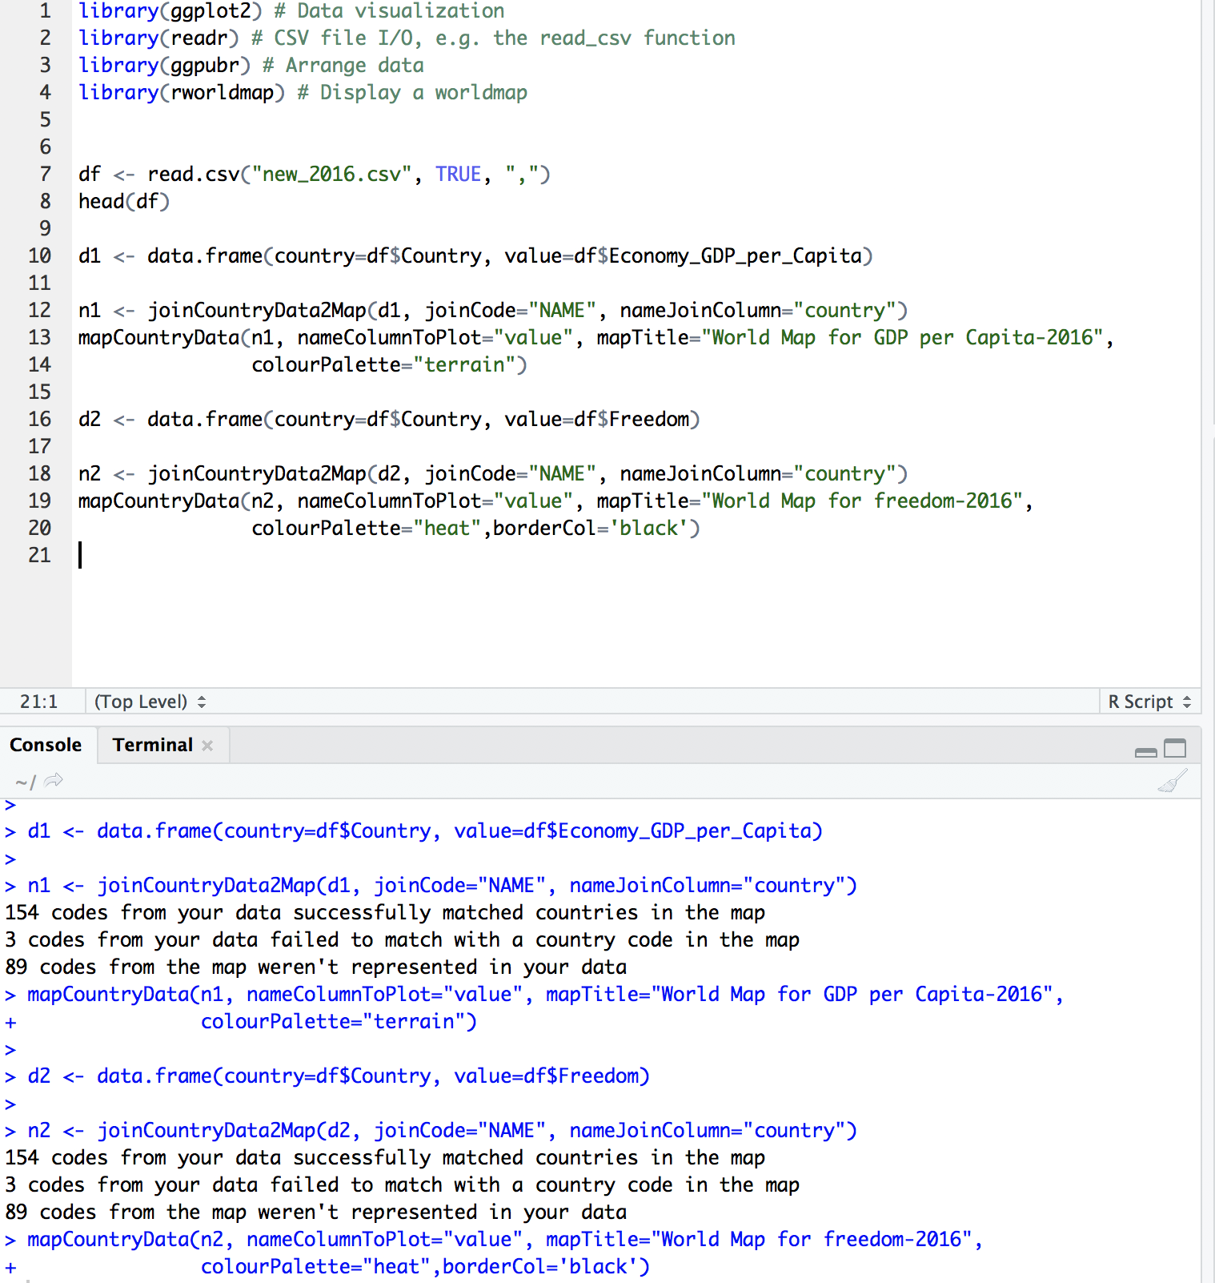
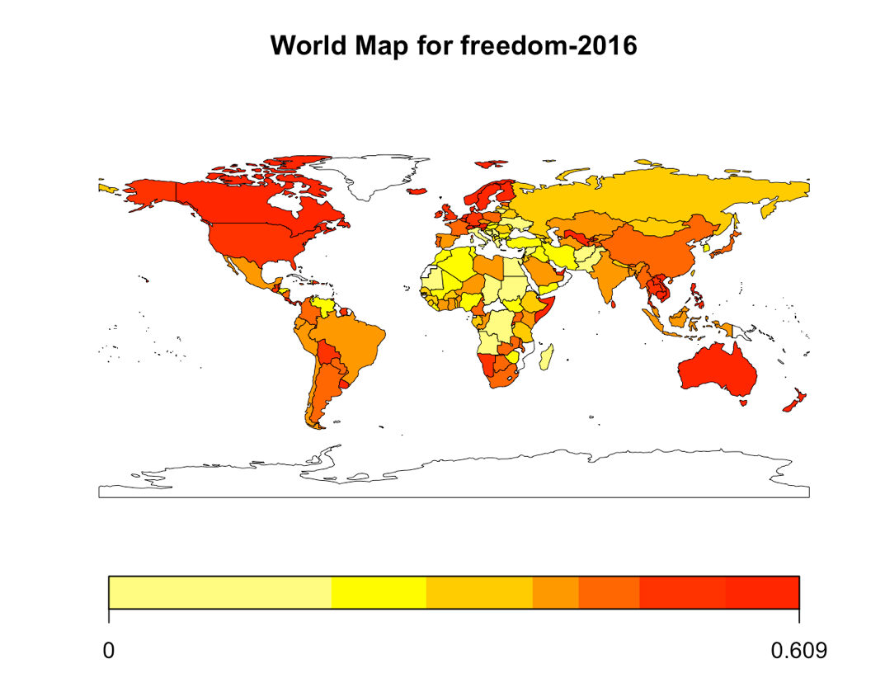
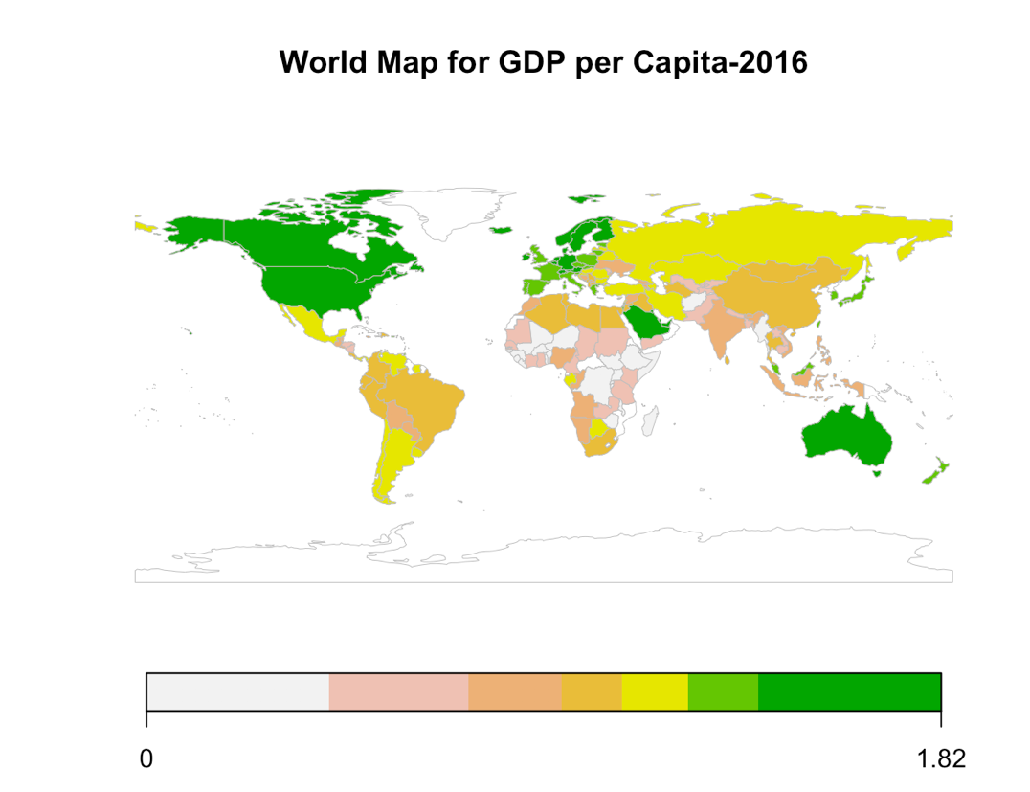
World Map Visualization

Slide 14
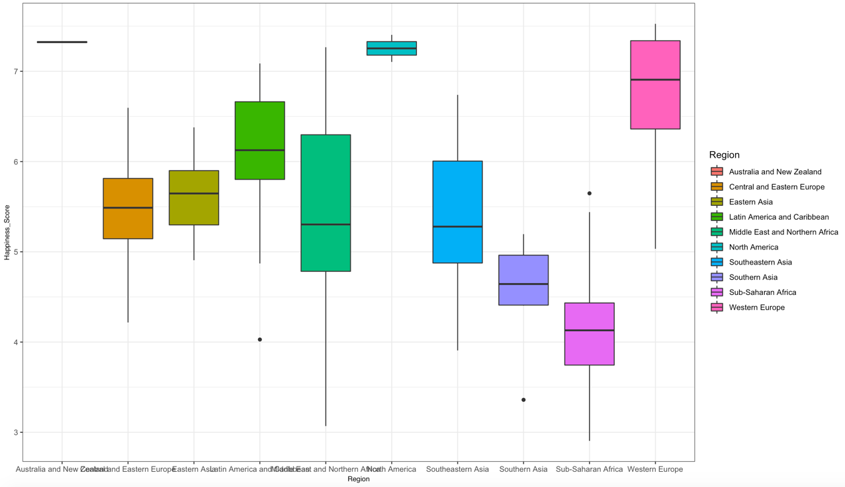
Box Plot – Happiness by regions

Slide 15
Summary
Understand how happiness is related with other factors.
Happiness and economy support each other.
The top happiness countries are mainly located in Western Europe.
Important to learn more about the statistics, besides programming.
Next step, learn some basic techniques about prediction.

Slide 16
Reference
Haybron, Daniel M., 'What is happiness?' in Happiness: A Very Short Introduction(Oxford, 2013; online edn, Very Short Introductions online, Sept. 2013), http://dx.doi.org/10.1093/actrade/9780199590605.003.0002, accessed 25 Nov. 2018.
Portilla, J. (n.d.). Learn how to use NumPy, Pandas, Seaborn , Matplotlib , Plotly , Scikit-Learn , Machine Learning, Tensorflow , and more! Lecture. Retrieved from https://www.udemy.com/python-for-data-science-and-machine-learning-bootcamp/learn/v4/overview
Sustainable Development Solutions Network. (2017, June 14). World Happiness Report. Retrieved November 25, 2018, from https://www.kaggle.com/unsdsn/world-happiness/home

